Slide 1

SegWaste Prototype Guide *To complement Adobe XD Wireframe
Made by ap6/2

Slide 2

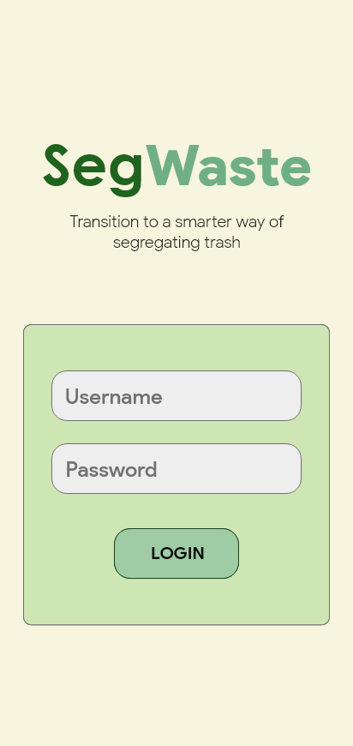
Login page
This is the starting page of the application. Authentication is required as a profile is needed to track each user’s progress, points, and information.
The Google Technology that will be used here is Firebase Authentication as it allows a secure method of saving user data over the cloud. There are also multiple sample codes that can be followed to help in our implementation.

Slide 3

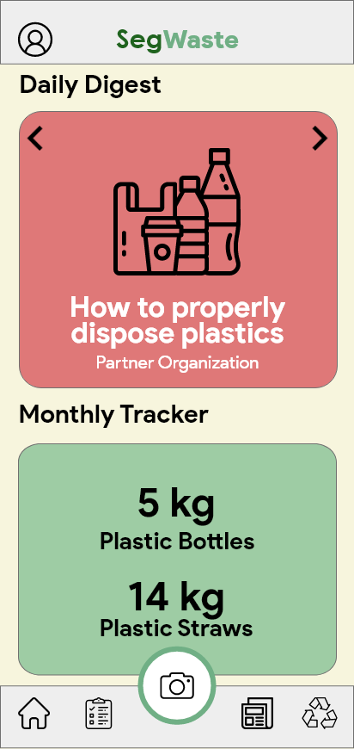
dashboard
Profile
The Dashboard will act as the home page of the application. A tab bar header and footer is present in almost every page of the application. The header will feature the current page name and a button for the profile. In some cases, the profile button will be replaced by a back button. The footer will simply include buttons that will take you to other pages.
The Dashboard will contain snippets from every feature. For example, a set of articles in the WastEd feature will be previewed here. It can also show the user’s monthly tracker, scheduled bookings, and other important information from other features.
WasteID
Home
Waste
Tracker
Waste
Education
WAYste

Slide 4
Profile page

Slide 5
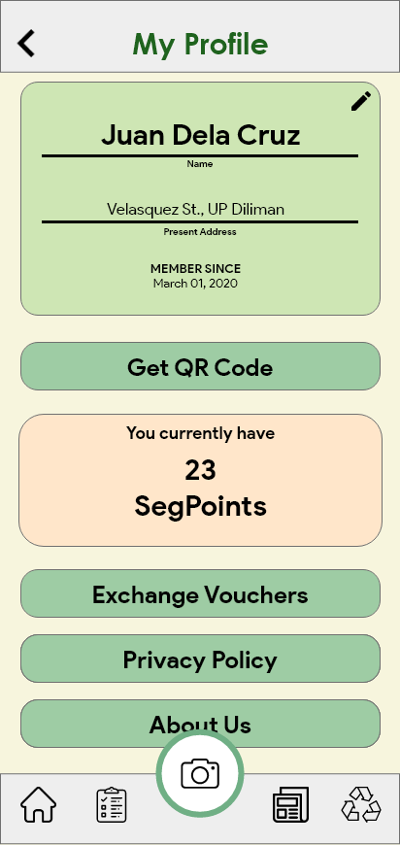
Profile page
The profile page allows users to edit their information and track their accumulated SegPoints. Storing of information is also done with Firebase and can be fetched or updated using API calls.
This page also allows you to get your QR Code, view exchange vouchers, and view the pages Privacy Policy and About Us.

Slide 6
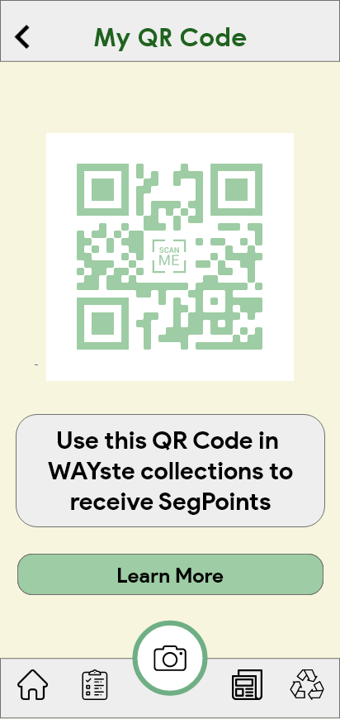
Get qr code
SegPoints are gained when an MRF scans your unique QR Code. Once the system is set, we will show specific instructions on how one can get SegPoints and other information about the said system. This data exchange will also be done using Firebase.

Slide 7
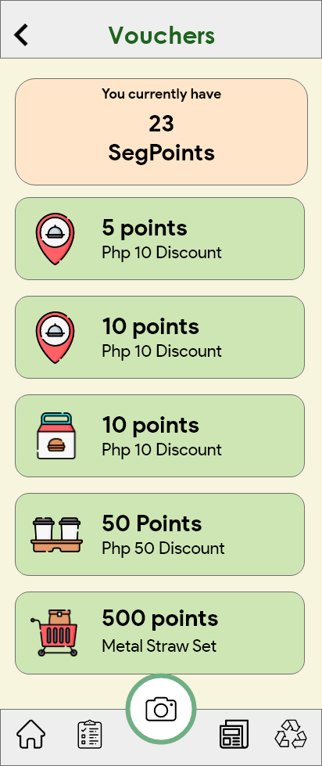
Exchange vouchers
This page shows different vouchers for discounts or freebies from our partner organizations. The redemption system will be similar to other applications commonly used.

Slide 8
Waste tracker

Slide 9
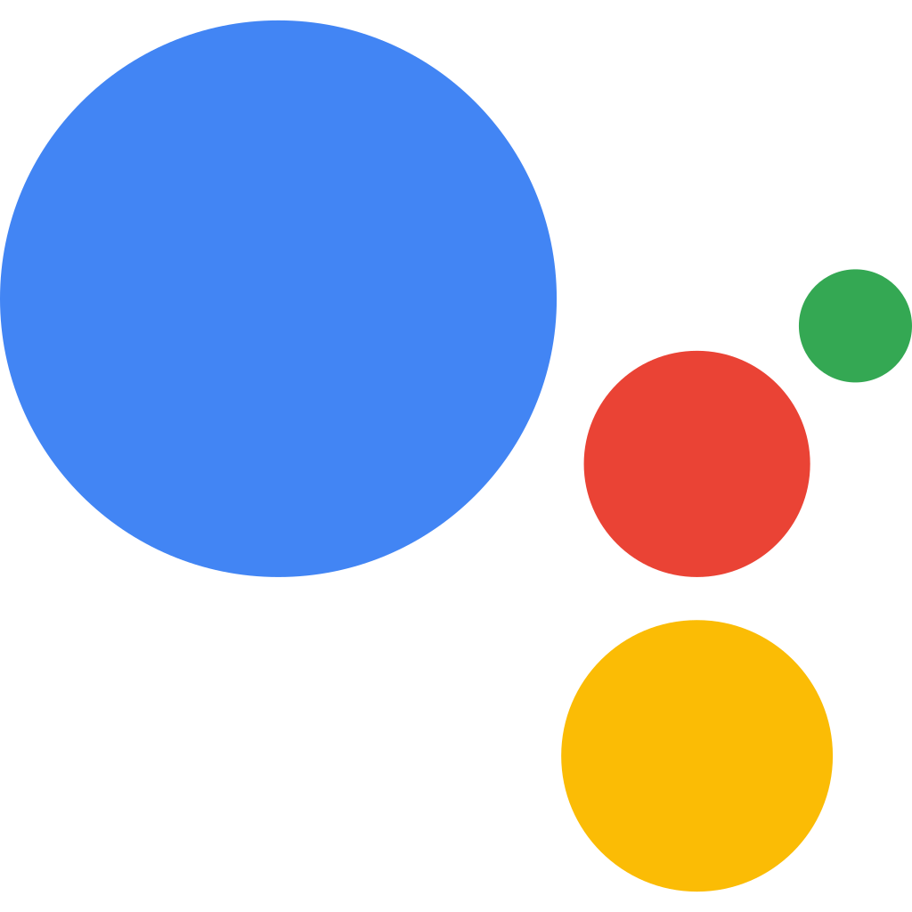
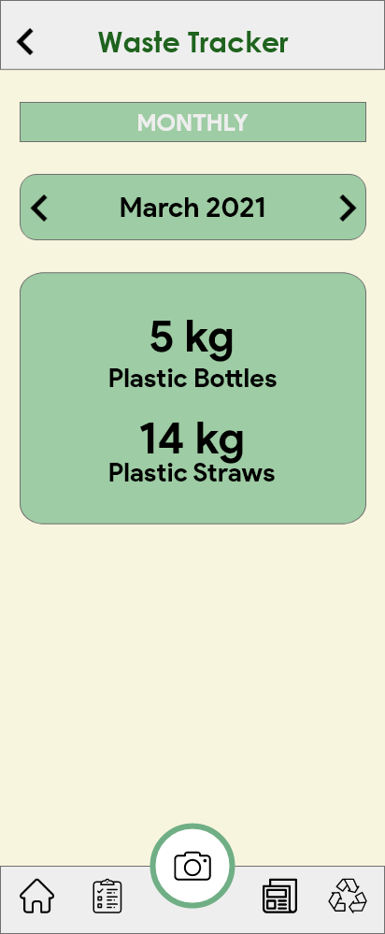
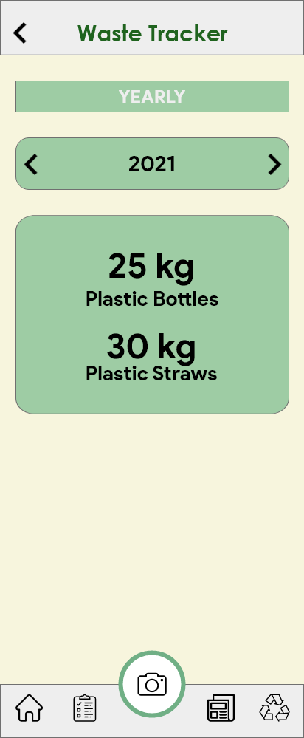
Waste tracker
This page is for tracking the user’s waste consumption and total donations. A simple button will toggle between Monthly and Yearly statistics. You can also simply navigate between months or years using buttons.
In the prototype, we give an example that shows how much plastic bottles and plastic straws each user has donated to remind them about their consumption. Later on, we can include other trackers for paper, single-use plastics, and other kinds of waste.
This feature can be integrated with Google Assistant’s App Actions and Android Slices to help with logging and getting small pieces of information.

Slide 10
Waste id

Slide 11
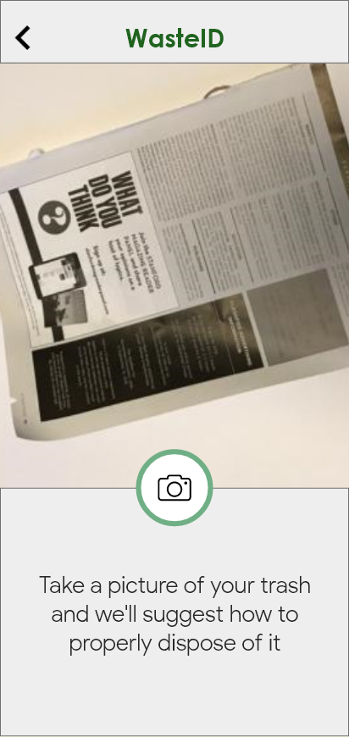
WASTEID PAGE
This is the starting page of the WasteID feature. It will ask the user to take a picture that will serve as an input to our classification model.

Slide 12

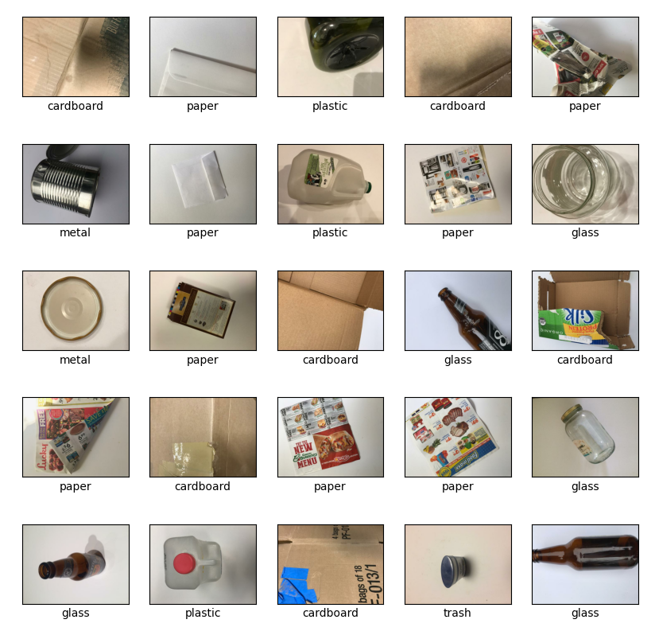
Tensorflow model
We trained a TensorFlow Image Classifier model with a trash dataset used in another study. We were able to achieve 86% accuracy. This can be improved later on once we tune the model and refine our dataset. We then converted this to a TensorFlow Lite model that can be integrated to our application.

Slide 13
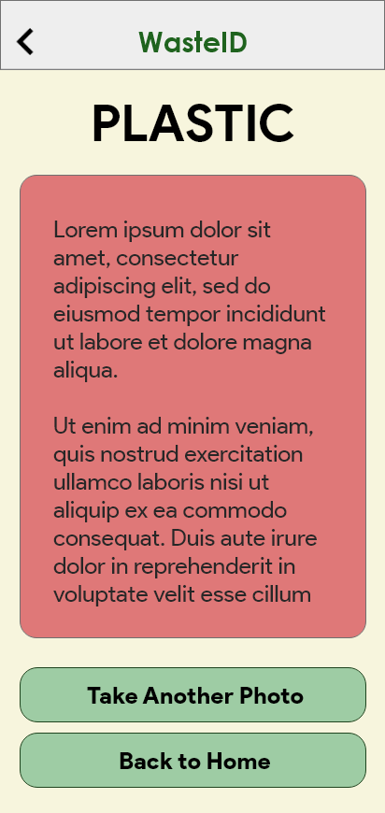
Classification result
After the classification, the user will be shown information regarding the material and its proper disposal method. The user can then decide if they want to use the feature again or go back to the dashboard.

Slide 14
Wasted (waste education)

Slide 15

WASTED PAGE
Various articles will be shown here, and we only show the title, thumbnail, and author for simplicity. Later on, we can implement sorting features and other QoL features.

Slide 16
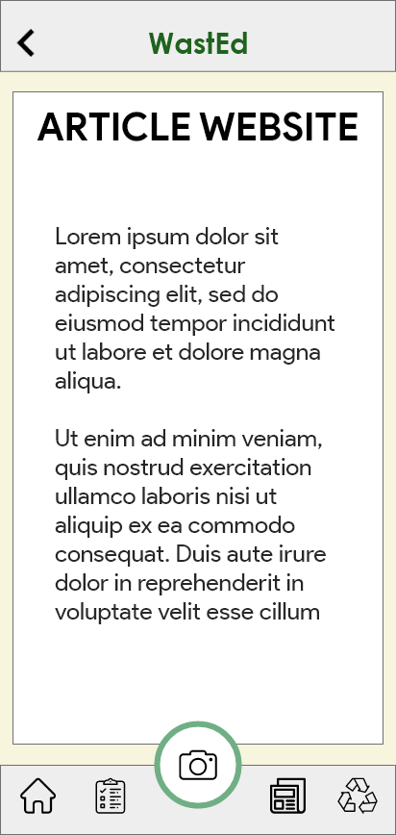
Article view
Once a card from the WastEd home page is clicked, they will be simply redirected to the specific website, infographic, or page.
We can integrate this with Google Assistant’s Read It feature to enhance our application’s accessibility.

Slide 17
wayste

Slide 18
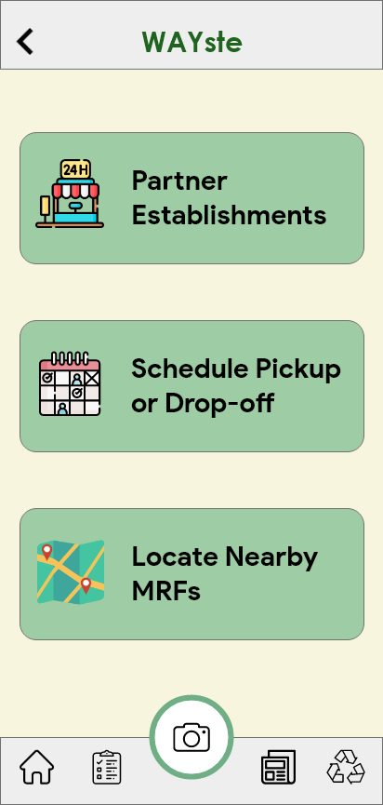
Wayste page
The WAYste page allows the user to choose between three sub-pages.

Slide 19
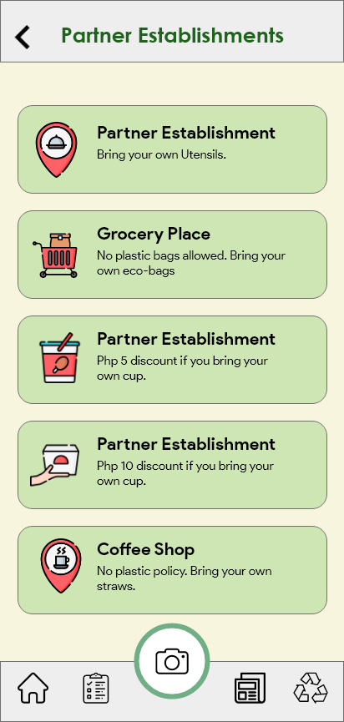
Partner establishments
This page shows information regarding initiatives of different establishments. For example, we will show if a specific café gives discount when you bring your own cup or straw. Another example is informing users about a grocery place or restaurant that follows a no plastic policy so they can prepare beforehand.

Slide 20
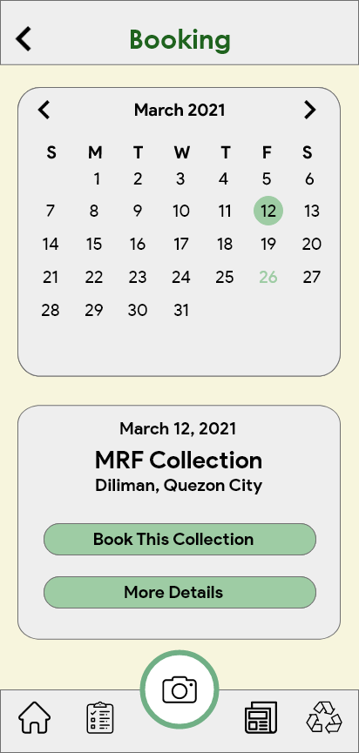
booking
This page features a calendar that allows users to coordinate with MRF’s for their waste disposal. Once a day is selected, it will be highlighted with a green circle and the bottom card will show relevant information and allow the user to book a schedule. All days with confirmed booking will be highlighted in green.
We will also utilize Firebase In-App Messaging (FIAM) to engage with our users in various ways and notify them about important announcements or reminders

Slide 21
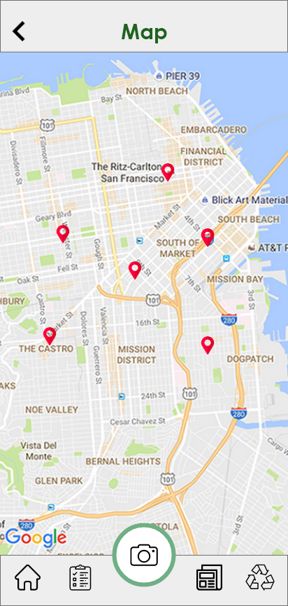
map
This page shows a map and markers for nearby MRFs. This can also be integrated with Google Assistant to assist users.

Slide 22
Thank you!
SegWaste
A transition aid to a smart, educational, and convenient way of segregating your trash
MADE BY AP6/2

